Slide 1

Group 1
DSI8 Project 4
Prediction West Nile Virus
In Chicago

Slide 2
Project members*
Michael Xiao
Jay Lee
Chow Mun Yang
Ferdi Garcia
Alfred Tang
* No specific order

Slide 3
Problem statement:
What features are most predictive of WNV-positive mosquito breeding behaviour?
How can we correctly predict the presence of WNV-positive mosquitoes?
False positives more acceptable than false negatives
What actions can be taken as a long-term solution to the spread of diseases by mosquitoes?

Slide 4
Executive summary
Features most predictive of WNV:
Weather
Month of year (season and weather)
Species of mosquito

Slide 5
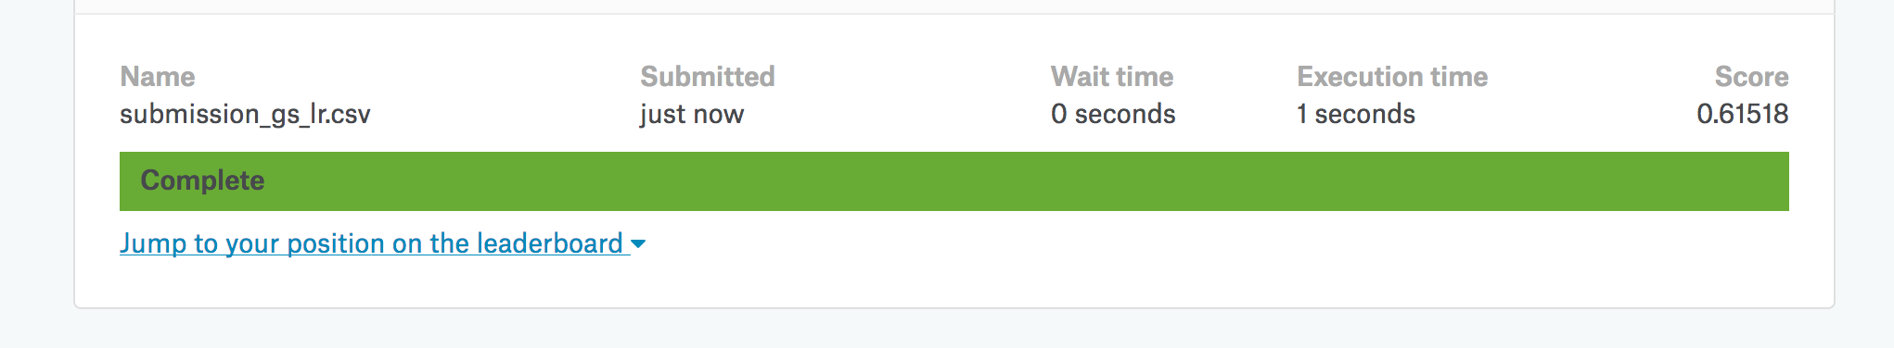
Executive summary
3 models attempted:
Logistic Regression
XGBoost
BernoulliNB
Best model: LogisticRegression
Precision – 0.11
Recall – 0.74
Kaggle score: 0.615

Slide 6
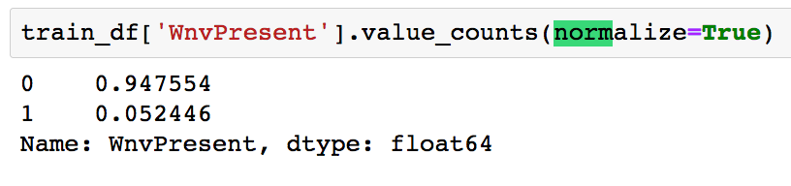
Exploratory Data analysis
Data clearning: data significantly complete and did not require much cleaning
Select features and features engineering
PCA (Principal Component Analysis):
Include features that has the most influence to the prediction
To consolidate (lessen) the features
There was an imbalance in the number of “WNVPresent” observations
StandardScaler
SMOTE resolved the imbalance

Slide 7
Feature engineering
From weather data:
temp_spread: Tmax-Tmin
Len_day1: length of the day (sunset – sunrise)
r_humidity: relative humidity
month: Months of May, June, July, October
Hot and humid weather conducive to mosquito reproduction
Mosquitos seek blood meals due to dehydration and reproduction
→ WNV mosquitoes more active in these months
From train data:
dist_ohare: distance from station 1
dist_mid: distance from station 2
sprayed: 5km around sprayed coordinate, within 3 days
Stations assigned based on proximity
Notes:
https://www.bostonglobe.com/metro/2016/07/15/most-mosquitoes-hate-hot--dry-weather-except-for-those-that-spread-west-nile-virus/E3SBJjMz1MyOJcp7TRgidM/story.html
https://www.sciencedaily.com/releases/2018/05/180501161827.htm
http://www.johnsnhweather.com/formulas/vaporPressure.html

Slide 8
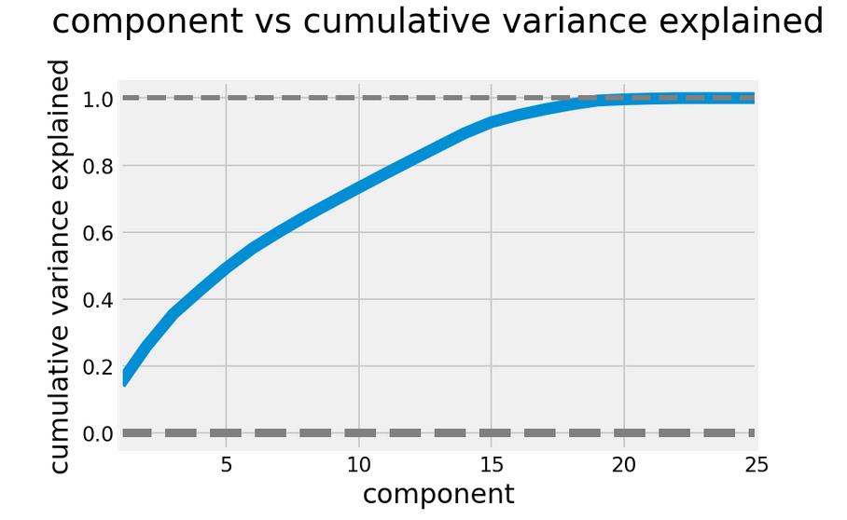
PCA

Slide 9
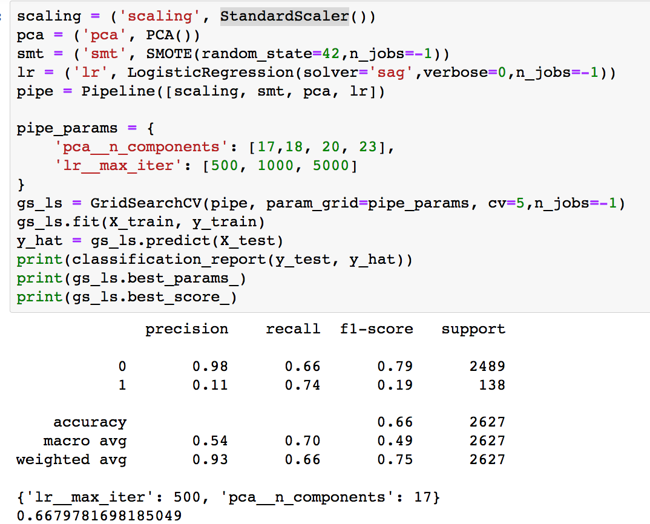
Logisticregression:

Slide 10
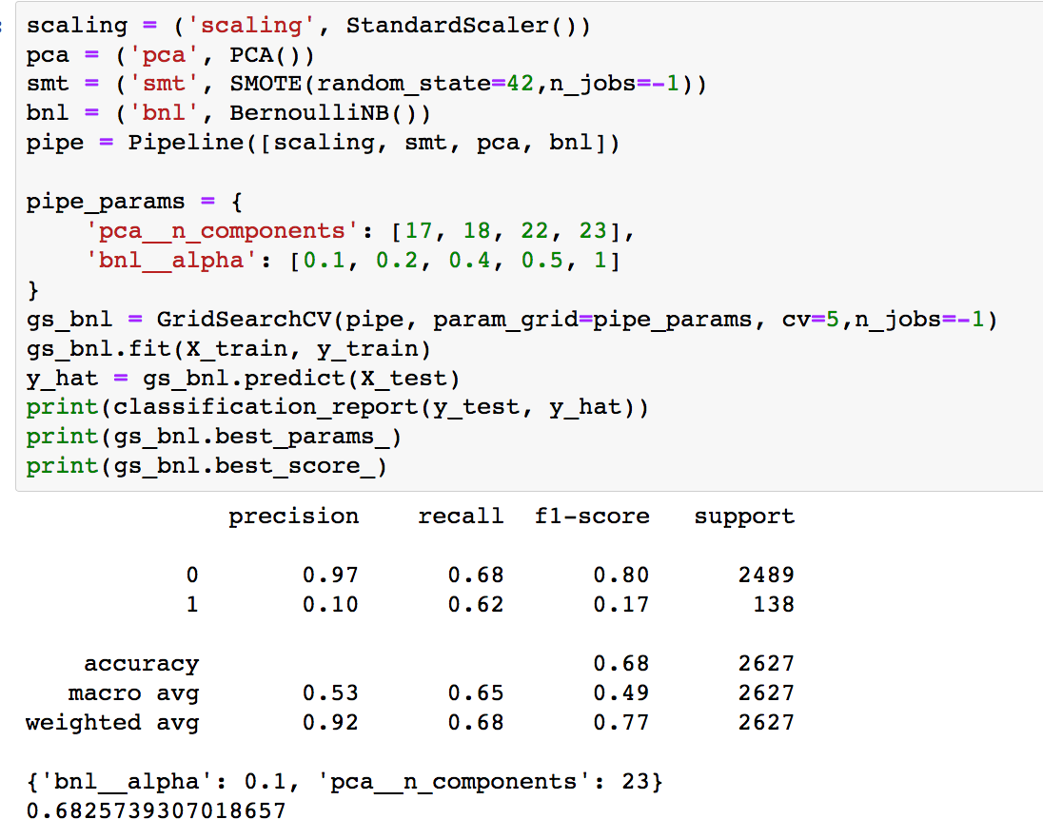
BernoulliNB:

Slide 11
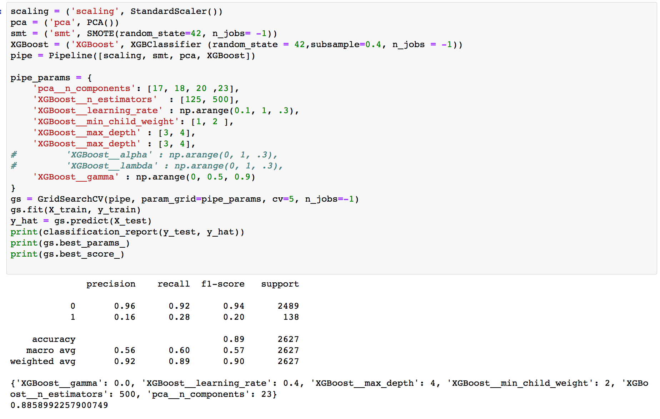
XGBoost:

Slide 12
Visualizations

Slide 13
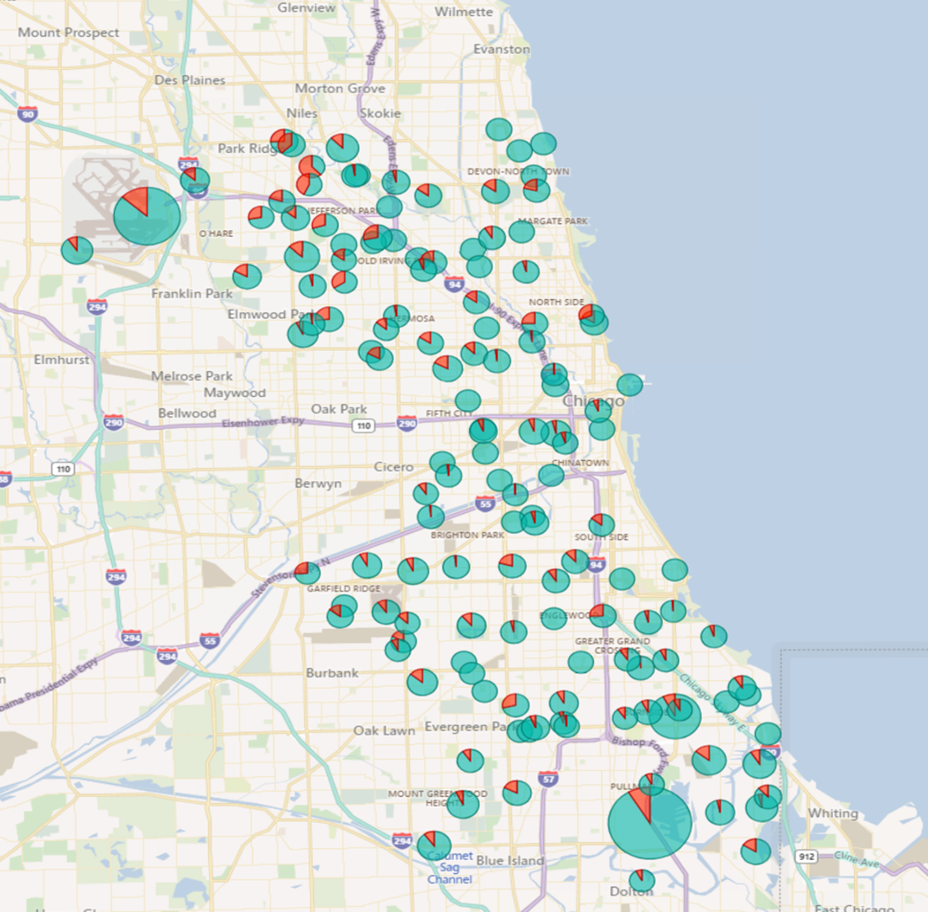
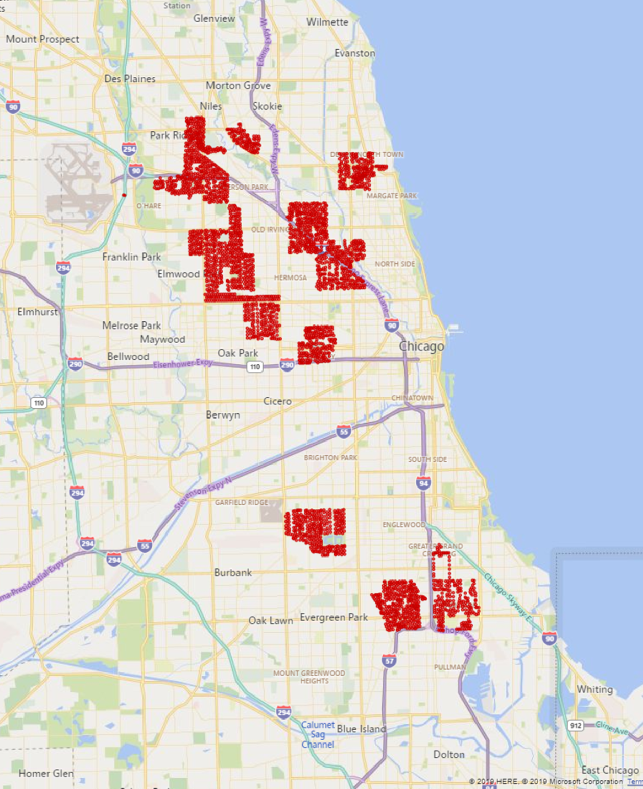
As of 26 Sep, 2013

Slide 14
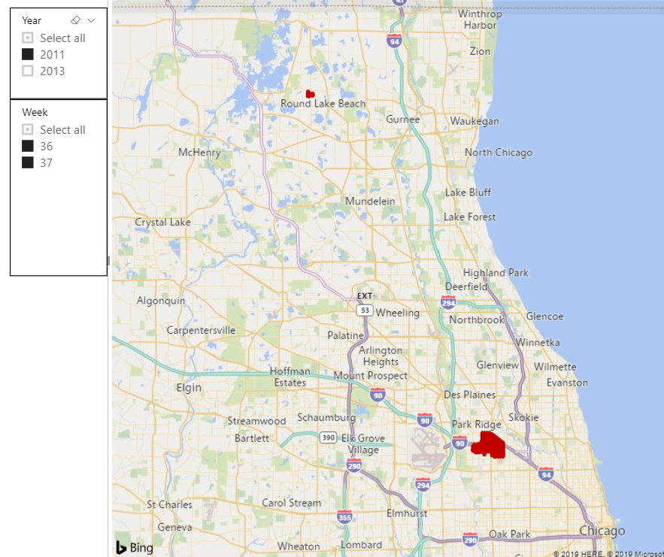
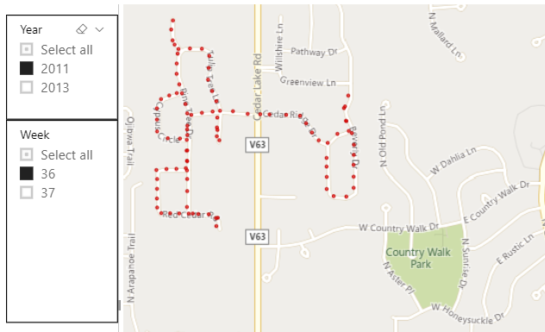
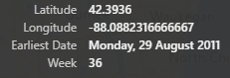
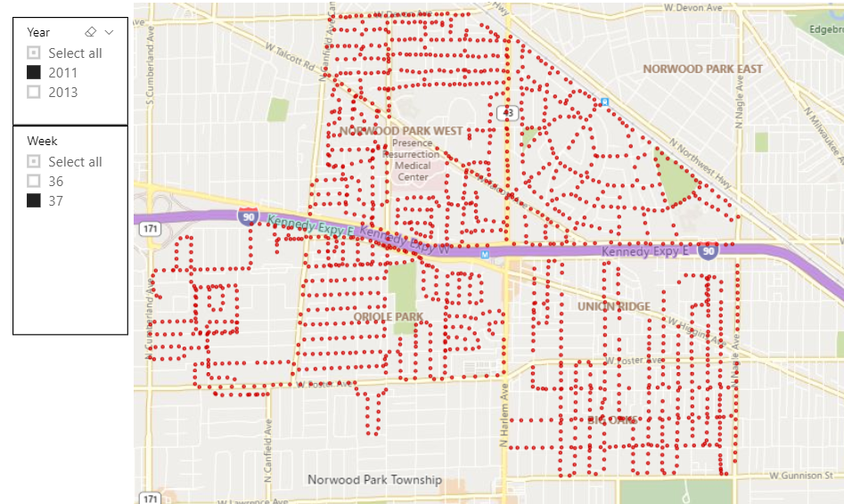
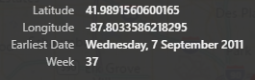
Round Lake was only sprayed once in 2011 and did not repeat as a WNV hotspot on 2013.

Slide 15
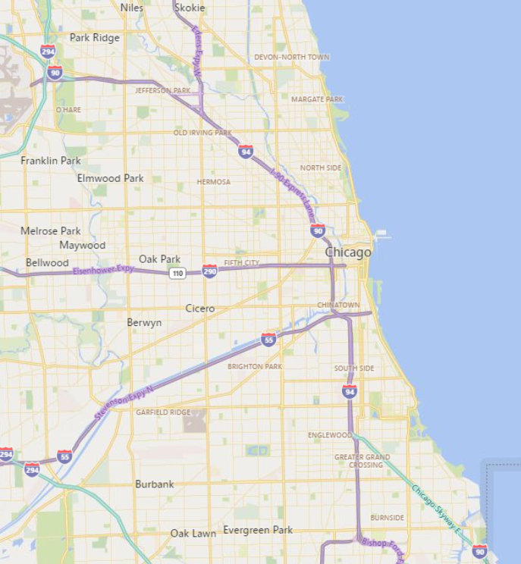
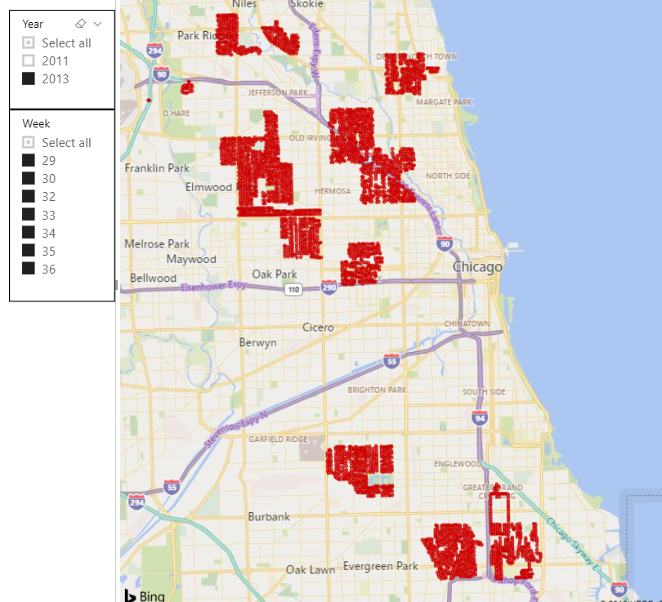
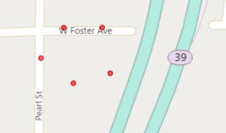
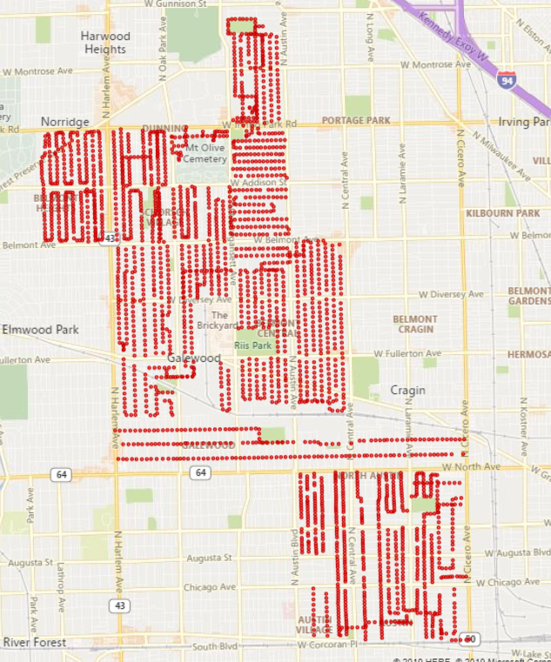
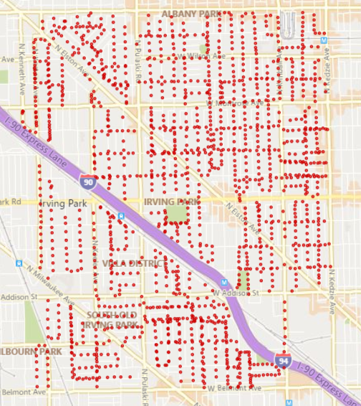
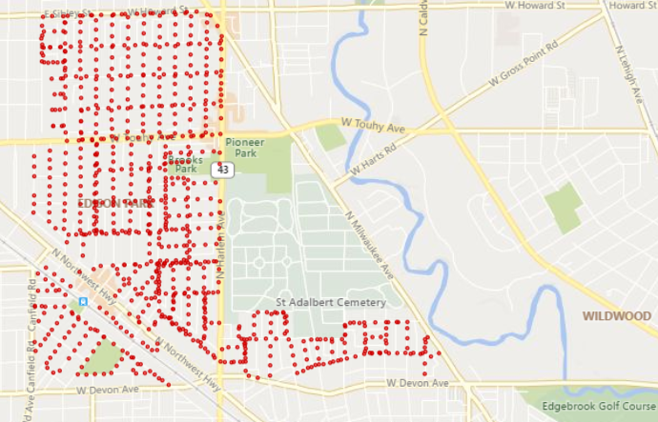
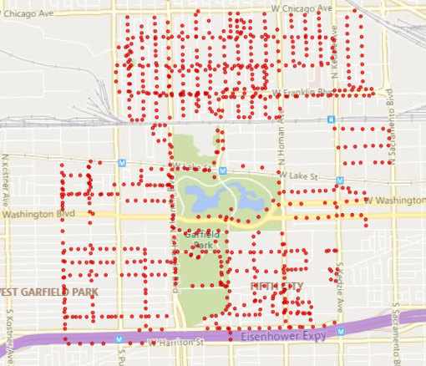
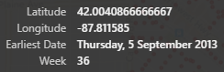
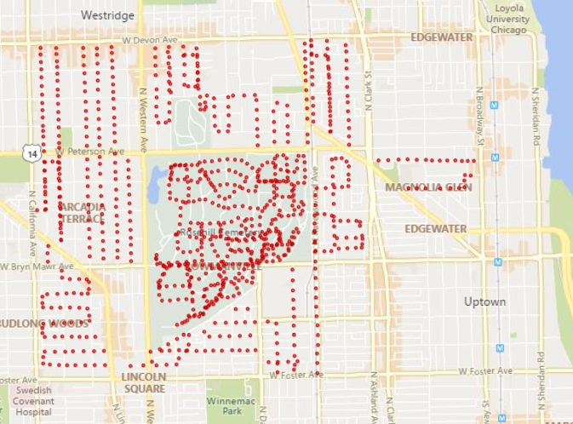

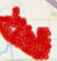
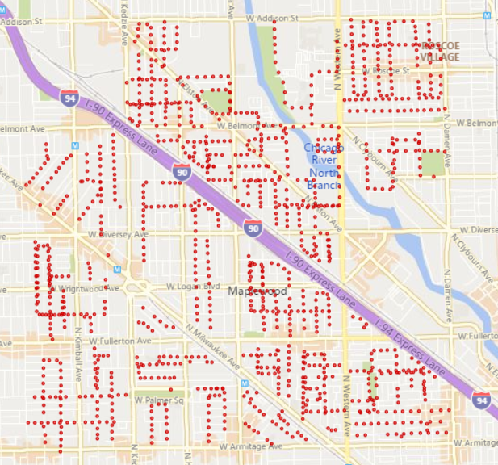
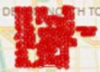
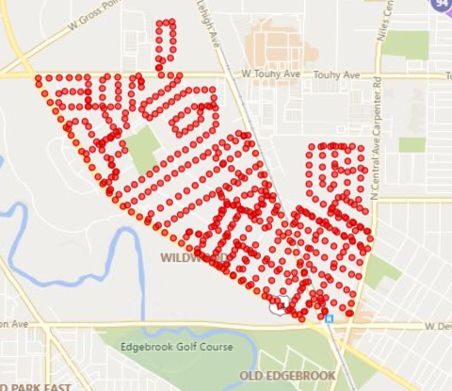

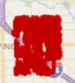
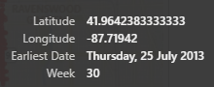
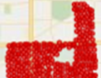

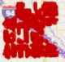
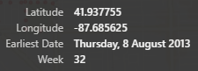
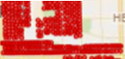
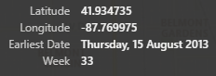


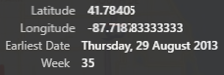
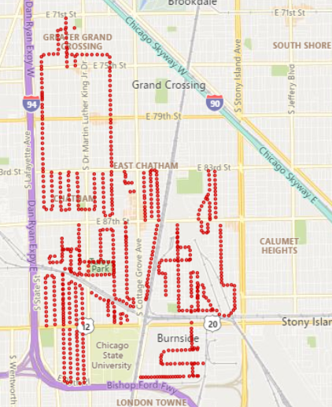
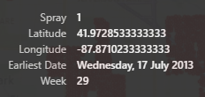
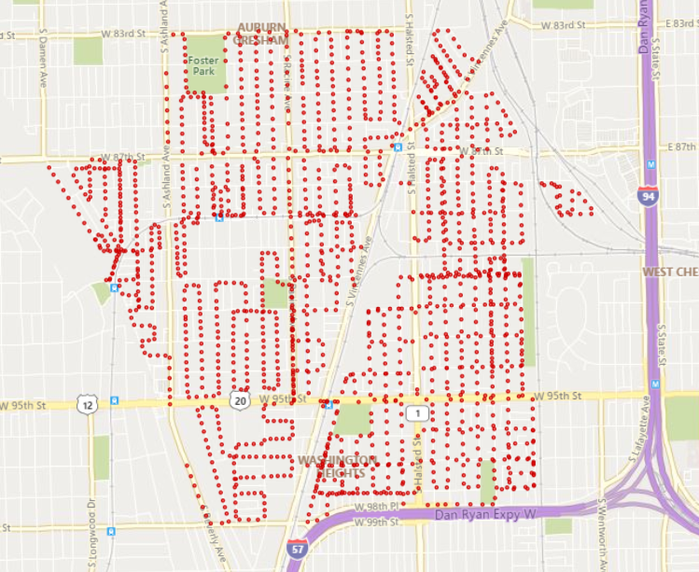
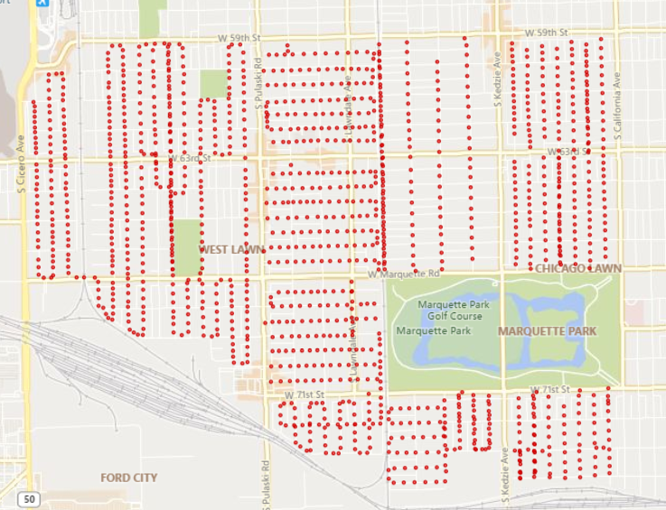
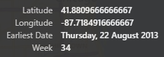
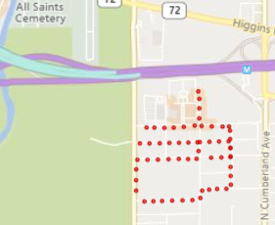
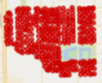
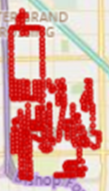
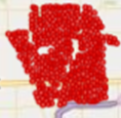

Slide 16
Findings and Observations

Slide 17
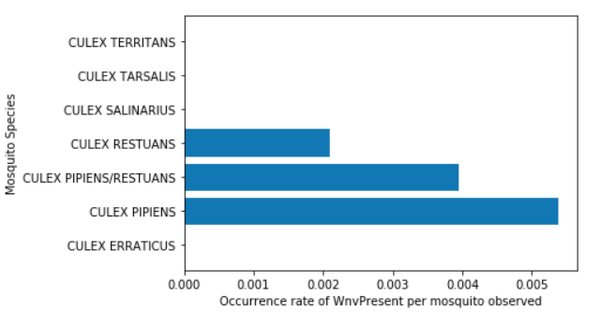
Mosquitoes as WNV Vectors
WNV Mosquitoes
Culex Pipiens - higher occurrence rate observed
Other Culex mosquitoes less active in same period
Culex Pipiens & Restuans
Same genus, high physical similarity
Differentiating traits don’t always appear

Slide 18
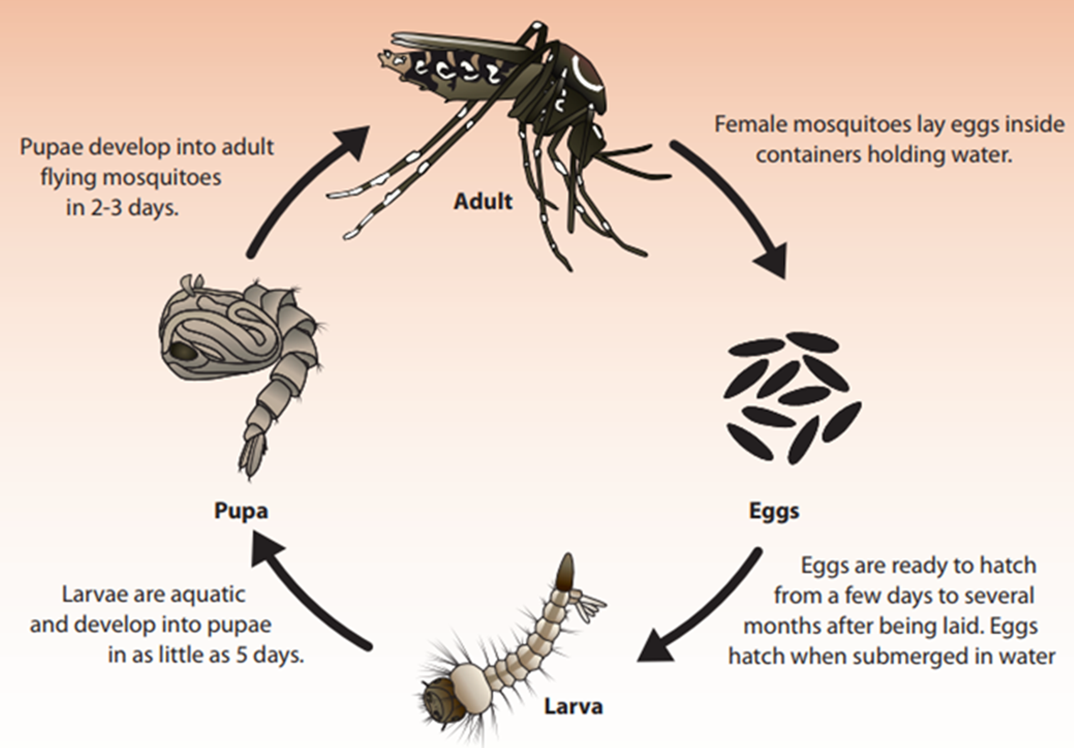
Mosquito Profile
Mosquito season starts in the summer (early July) and continues through fall (late September)
Female adult can lay up to 100 eggs at a time; usually from early sprint to late fall
4 phases of Mosquito development:
From egg to larva: 1 – 2 days
From larva to Pupa: 5 – 7 days
From Pupa to adult: 2 - 3 days
Egg to adult: 12 days approx.
Mosquito lifespan:
Adult Male : 10 days
Adult Female : 42 – 56 days

Slide 19
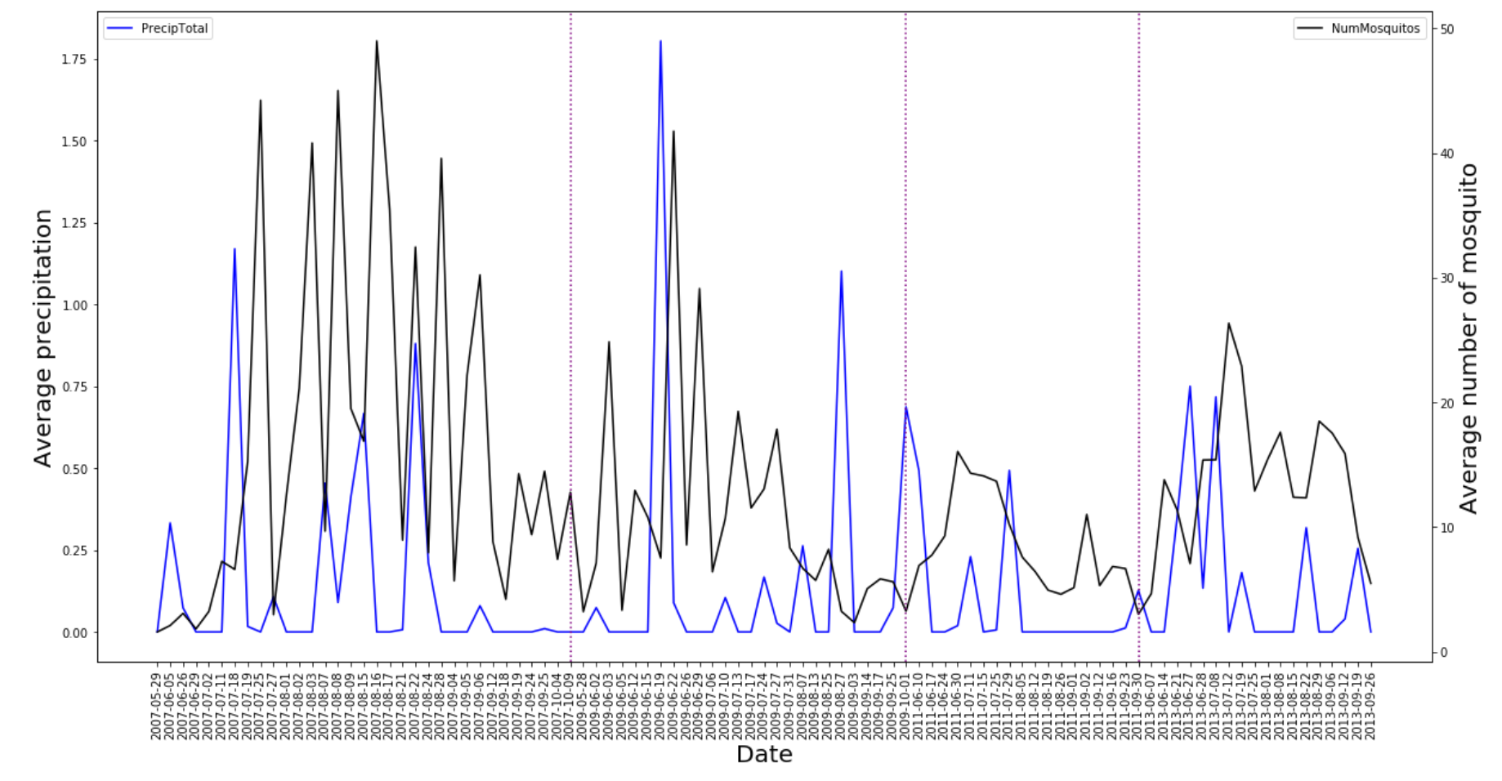
Comparison of the trend for average precipitation and average number of mosquitos over time
Female mosquitoes lay “dry eggs” that need water to activate them and cause them to hatch. Lots of mosquito eggs hang out on the inside walls of containers waiting to be hatched into action by a passing rain shower.

Slide 20
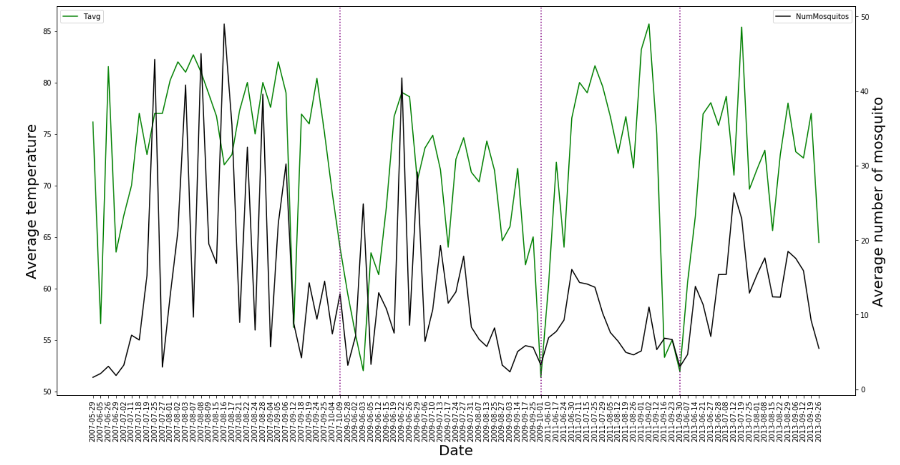
Comparison of the trend for average temperature and average number of mosquitos over time
Mosquitoes love warm climates, they are active once temperatures are consistently above 10 degrees, but activity tends to peak when the temperature is 26 degrees Celsius and above.

Slide 21
Mosquito control
Underlying philosophy: greatest control impact on mosquito populations will occur when they are concentrated, immobile and accessible.
Most mosquitoes can fly no more than about 1 to 3 miles (1.6km to 4.8km).
Mosquitoes often stay within several hundred feet of where they were hatched.
3 feet ~ 1 metre
Larvicides - For larvae in standing water
Can target only mosquito breeding sites
Less impact on environment
Effectivity up to 1 month after application

Slide 22
Mosquito control
adulticides – For winged mosquitoes
Very fine ultra-low-volume (ULV) droplet spray from a truck or aircraft
Droplets too large/too small won’t work
Affects insects, birds, fish, and mammals, including humans
Little residual effect – breaks down within 24h
Repeat applications needed
Mosquito numbers return to pre-treatment levels within a few days

Slide 23
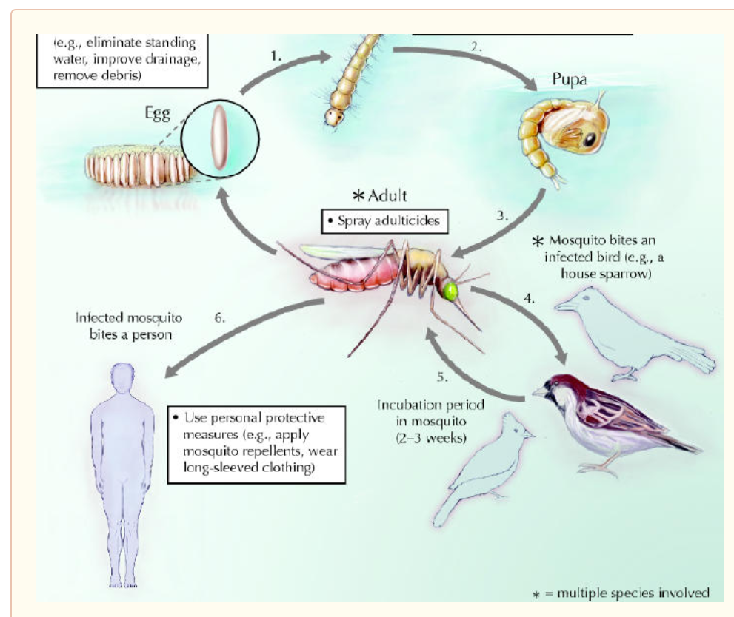
ENVIRONMENT ISSUES
WNV depends on continuous transmission between certain species of birds and mosquitoes:
Mosquito bites infected bird
Passes it to next animal bitten
Humans are accidental link in viral chain
During winter, mosquitos may:
Hibernate (as adults) in burrows and basements
Lay dormant eggs and die
Eggs may already be infected with WNV
Eggs will infect the local bird population to continue the cycle

Slide 24
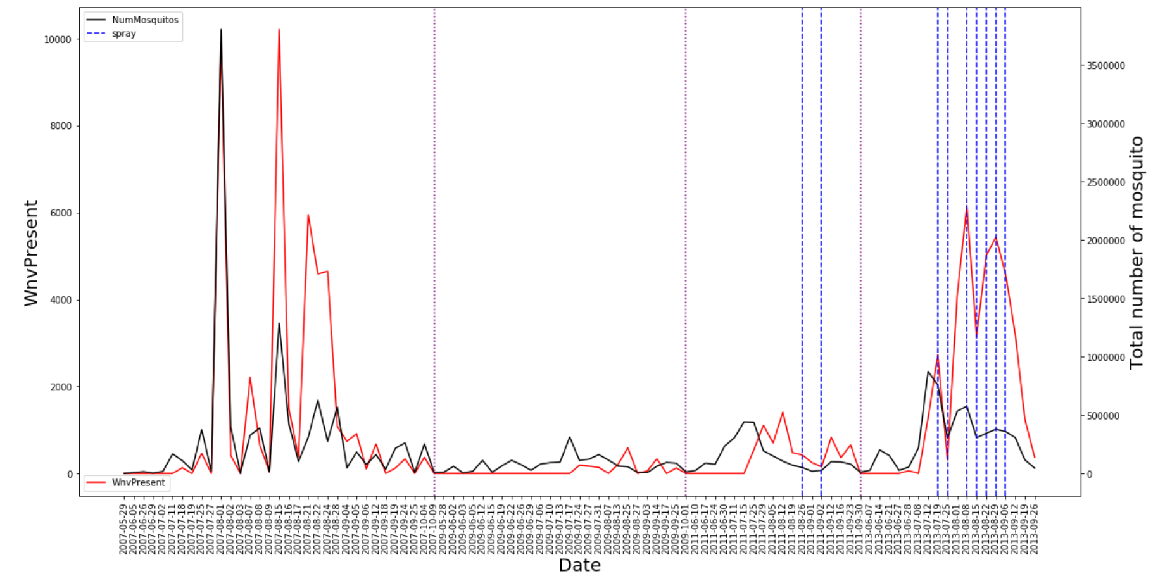
TrenD Comparison: WnVPresent VS total mosquitoES
Naturally, total mosquitoes is correlated with WNVPresent.
Also note the influence of the spray on the mosquito population and effect of discontinued spraying.

Slide 25
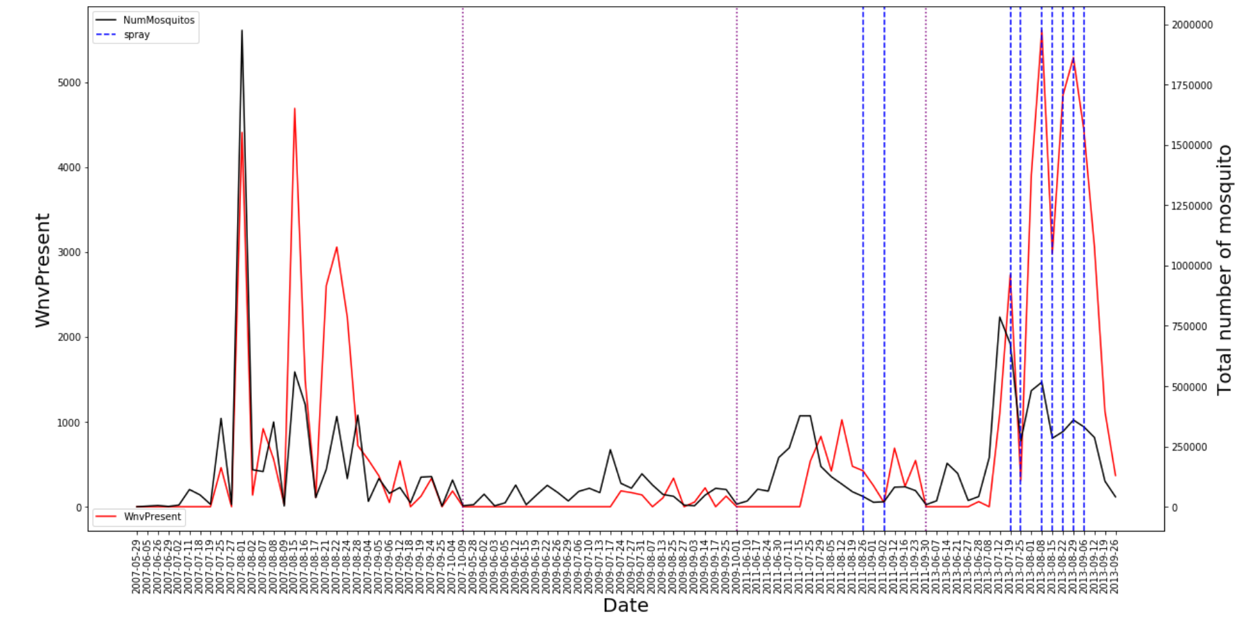
TrenD Comparison: WnVPresent VS total mosquitoES
Areas with high level of WNV occurrence were targeted for spraying.

Slide 26
Conclusion
Best model - Logistic Regression:
Accuracy: 0.66
Recall: 0.74
Precision: 0.11

Slide 27
recoMmendations
To contain the spread of WNV in Chicago:
Identify, monitor, and eliminate mosquito breeding areas
Use larvicides consistently for 1 breeding year (July to September)
Awareness campaign:
Areas to avoid during mosquitoes’ preferred breeding months
How to remove possible breeding areas in your neighbourhood
How to identify and report breeding areas to authorities

Slide 28
References
https://www.megacatch.com/mosquito-faqs/mosquito-facts.html
https://www.epa.gov/mosquitocontrol/joint-statement-mosquito-control-united-states
https://blogs.biomedcentral.com/bugbitten/2017/12/01/where-does-west-nile-virus-go-in-winter/
https://www.caryinstitute.org/newsroom/west-nile-virus-beats-winter
https://thebugman.us/bug-basics-why-do-more-mosquitoes-appear-after-it-rains/
https://blog.mosquito.buzz/how-weather-affects-mosquito-activity

Slide 29


